Slide 1
Angle of reflection
A ray of light reflects off a flat mirror. It all reflects in one direction.
It reflects at the angle of reflection.

Slide 2
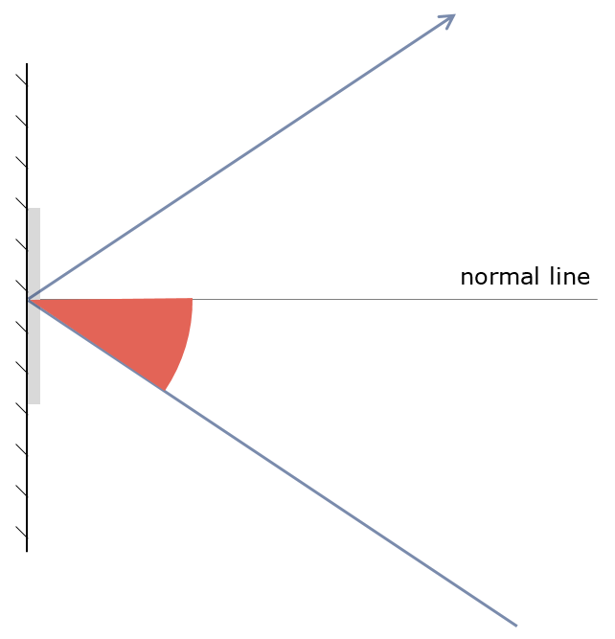
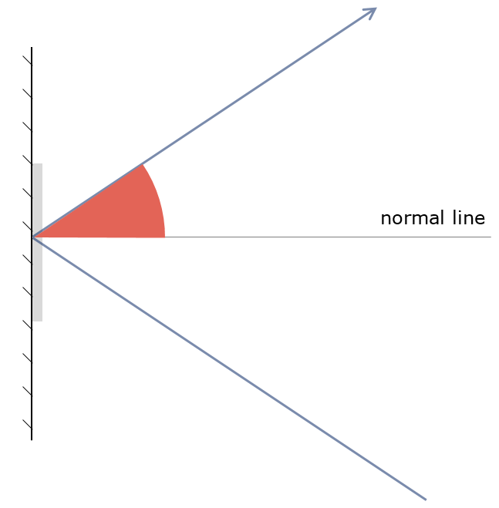
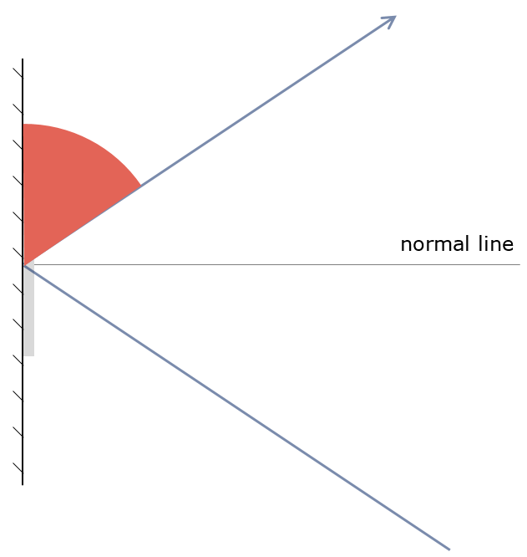
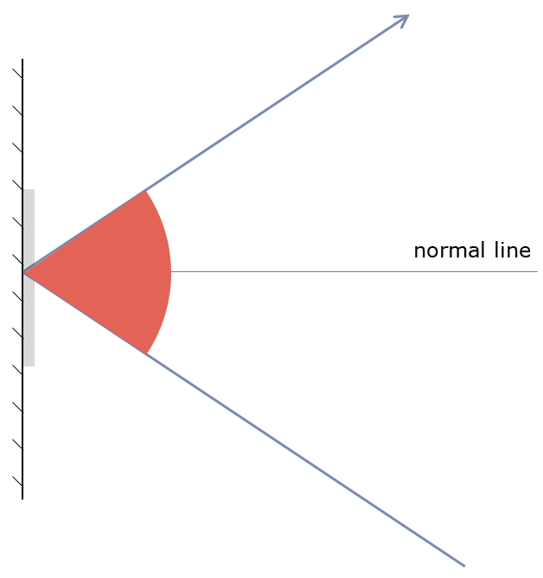
Angle of reflection
Which picture shows the angle of reflection?
A
B
C
D

